Slide 1
AI fruit Freshness Detector

Slide 2
Team 4
Mansi Karnatak
Anchal
Jyoti
Anuradha
Mahima

Slide 3

Work Division
Contribution of each team member in project
Mansi (Leader + Coding): Manages project planning, coordination, dataset handling, CNN model development, and final integration of the system.
Jyoti (Coding – Backend & API): Develops Flask/Streamlit backend, connects model with application, handles image input and prediction output.
Anuradha (Coding – Dataset & Model Training): Collects dataset, performs preprocessing, helps in CNN model training and improves accuracy.
Anchal (PPT Preparation): Creates presentation slides, explains project overview, methodology, model working, and results.
Mahima (Documentation): Prepares full project report including abstract, objectives, methodology, results, conclusion, and screenshots.

Slide 4

The background
Fruit freshness is usually judged manually, which can be inaccurate and inconsistent. With increasing food waste, there is a need for an automated system. This project uses AI and image processing to detect whether fruits are fresh or rotten based on visual features like color and texture.

Slide 5
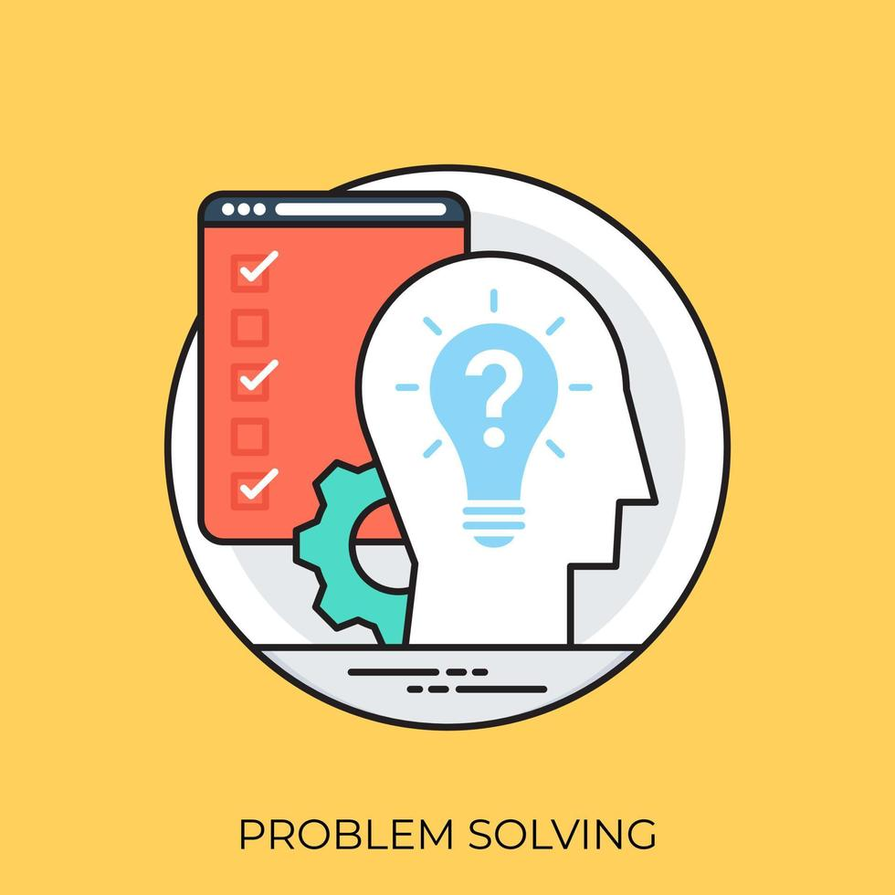
PROBLEM STATEMENT
Identify whether fruits or vegetables are fresh or rotten using image classification.
Problem statement

Slide 6

Proposed Solution
An AI-based system will be developed to detect fruit freshness using image processing and machine learning, where the model analyzes uploaded images and classifies fruits as fresh or not fresh.

Slide 7

Technology Stack & Requirements
Programming Language: Python
Libraries: TensorFlow / Keras, OpenCV, NumPy, Pandas
Model: Convolutional Neural Network (CNN)
Tools: Jupyter Notebook / VS Code
Dataset: Fruit images (fresh & rotten)
Frontend (optional): Streamlit / Flask for UI
Hardware Requirements: Basic CPU/GPU system with 4–8 GB RAM
Software Requirements: Python 3.x, pip packages installed

Slide 8

Innovative Idea
An upgraded AI system that not only detects fruit freshness from images but also predicts remaining shelf life (how many days it will stay fresh) and gives storage suggestions.

Slide 9

Results / Outcomes / Analysis
The developed AI model effectively classifies fruits as fresh or not fresh based on image input with good accuracy. The system shows reliable performance on test images, demonstrating that CNN-based image classification is suitable for freshness detection. It helps in reducing food wastage and improves decision-making for users. Further improvements can increase accuracy and expand detection to more fruit types and shelf-life prediction.

Slide 10

Limitations
Accuracy depends on the quality and size of the dataset
May give incorrect results for unclear or low-light images
Limited to fruits included in the training dataset
Cannot detect internal spoilage (only visual appearance is used)
Requires improvement for real-time and diverse environment performance

Slide 11

Future Scope
Detect fruit freshness using image classification (fresh / not fresh)
Support multiple fruit types
Real-time image prediction through camera or upload
Simple user-friendly interface (web or mobile app)
Future scope includes shelf-life prediction, ripeness level detection, and smart storage recommendations using AI and IoT integration

Slide 12
karnatakmansi149/AI-Fruit-Freshness-Detector

Slide 13
Thank You

